Slide 1
Cycloid Reducer
周奕彬

Slide 2
大綱
新擺線輪輪廓解析式
等效連桿-曲率半徑
未來目標轉換角

Slide 3
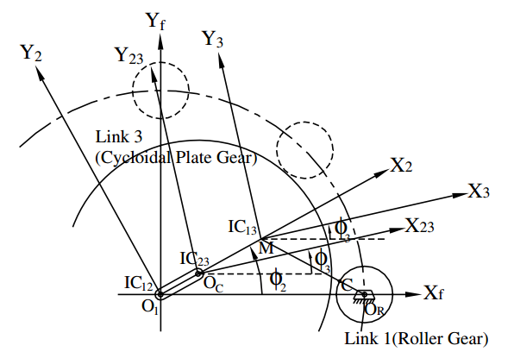
Stationary ring gear type epicycloid reducer

Slide 4
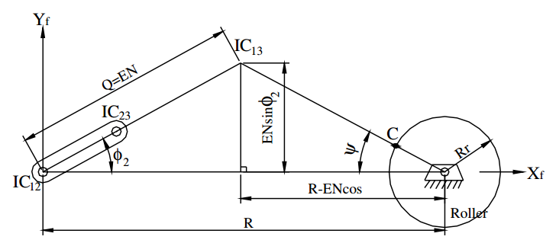

$\overline{IC23IC13}+\overline{IC13Or}+\overline{OrC}$

Slide 5
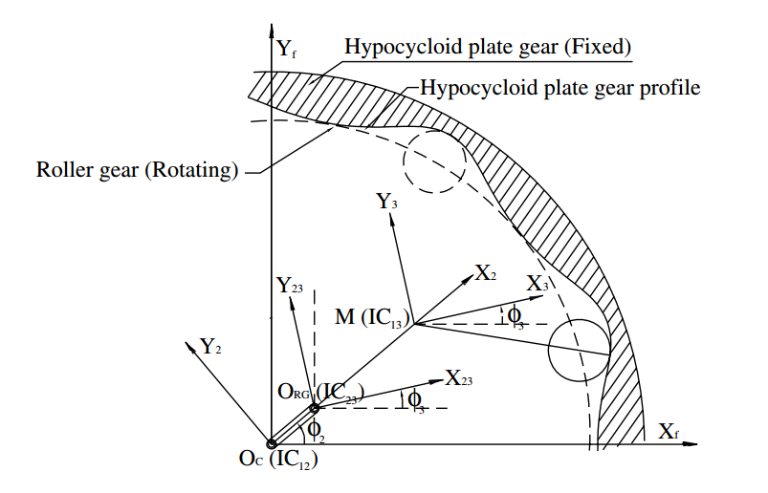

Slide 6
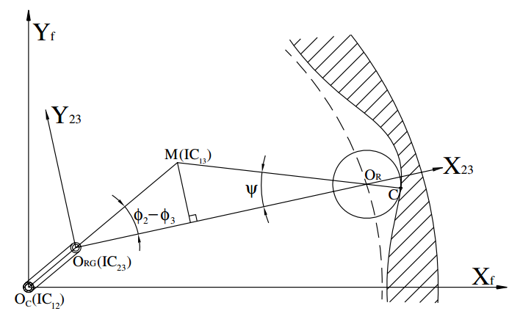

Stationary ring gear type hypocycloid reducer
$\overline{IC23IC13}+\overline{IC13Or}+\overline{OrC}$

Slide 7
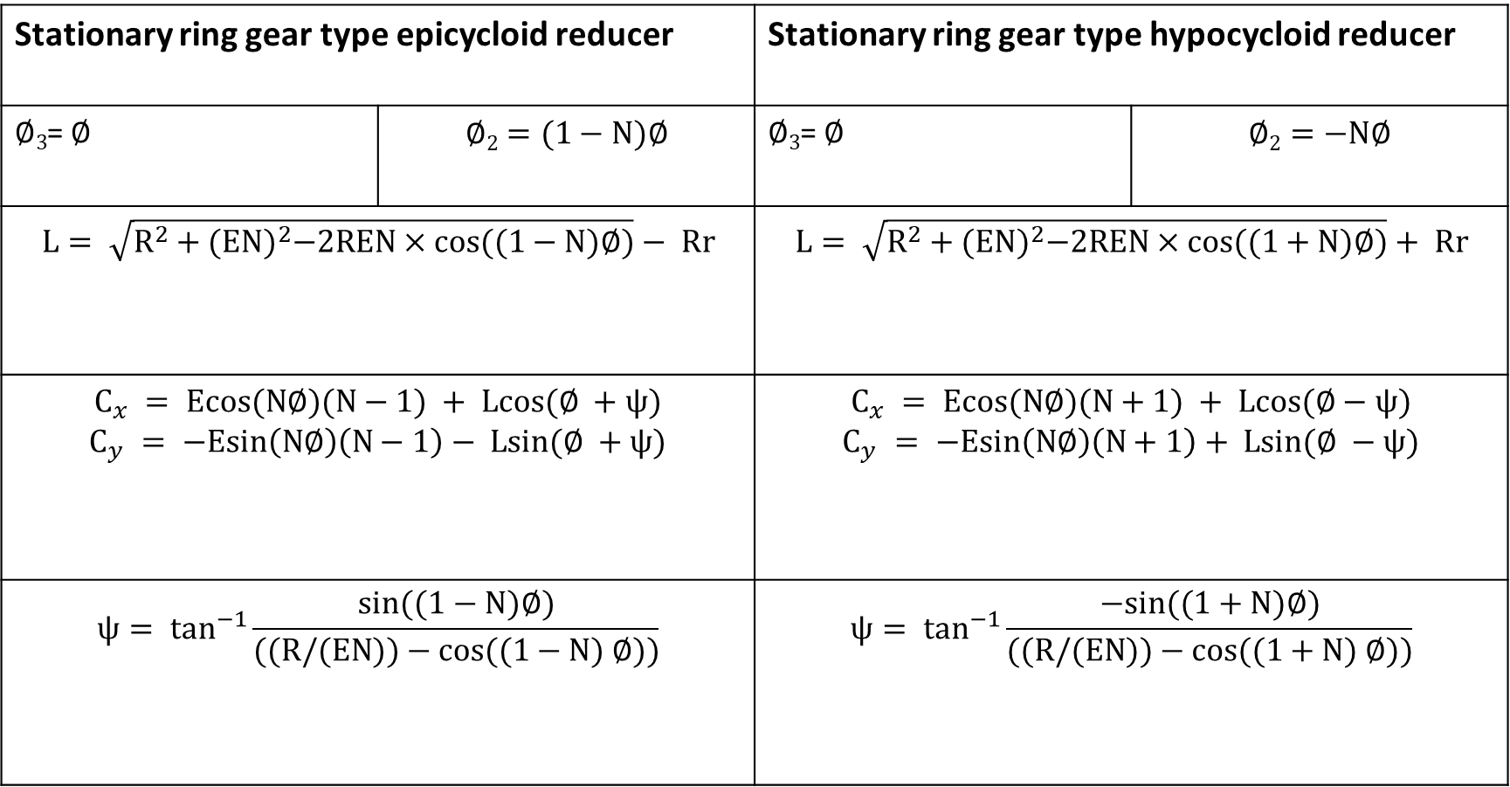
Stationary ring gear type epicycloid reducer |  | Stationary ring gear type hypocycloid reducer
$∅3$= $∅$ | $$∅2=(1−N)∅$$ | $∅3$= $∅$ | $$∅2=−N∅$$
$$L= \sqrt{R^{2}+{(EN)}^{2}−2REN×cos((1−N)∅)}− Rr$$ |  | $$L= \sqrt{R^{2}+{(EN)}^{2}−2REN×cos((1+N)∅)}+ Rr$$
$$C_{x} = Ecos(N∅)(N−1) + Lcos(∅ +ψ)$$ $$C_{y} = −Esin\left(N∅\right)\left(N−1\right)− Lsin(∅ +ψ)$$ |  | $$C_{x} = Ecos(N∅)(N+1) + Lcos(∅−ψ)$$ $$C_{y} = −Esin\left(N∅\right)\left(N+1\right)+ Lsin(∅ −ψ)$$
$$ψ= \tan^{−1}{\frac{sin((1−N)∅)}{((R/(EN))−cos((1−N) ∅))}}$$ |  | $$ψ= \tan^{−1}{\frac{−sin((1+N)∅)}{((R/(EN))−cos((1+N) ∅))}}$$

Slide 8
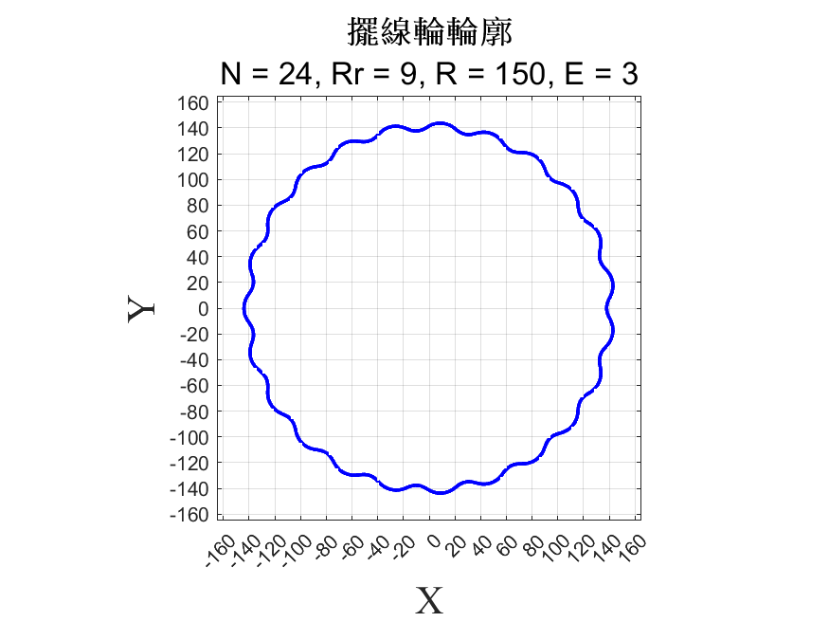
曲率半徑

Slide 9
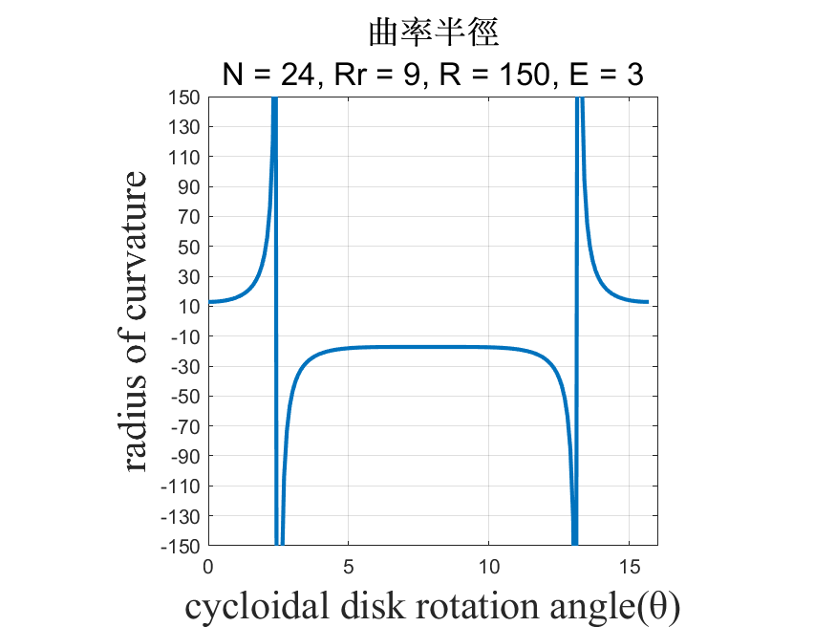
曲率半徑

Slide 10
強調週期 圈齒

Slide 11
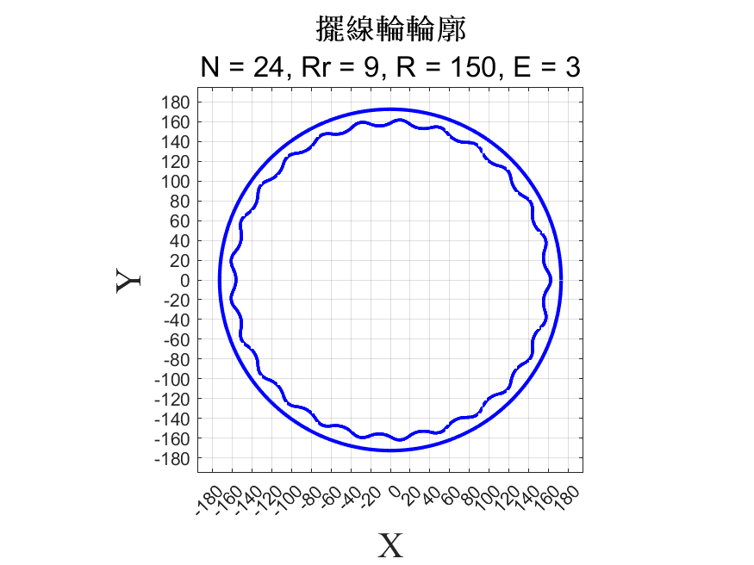
曲率半徑

Slide 12
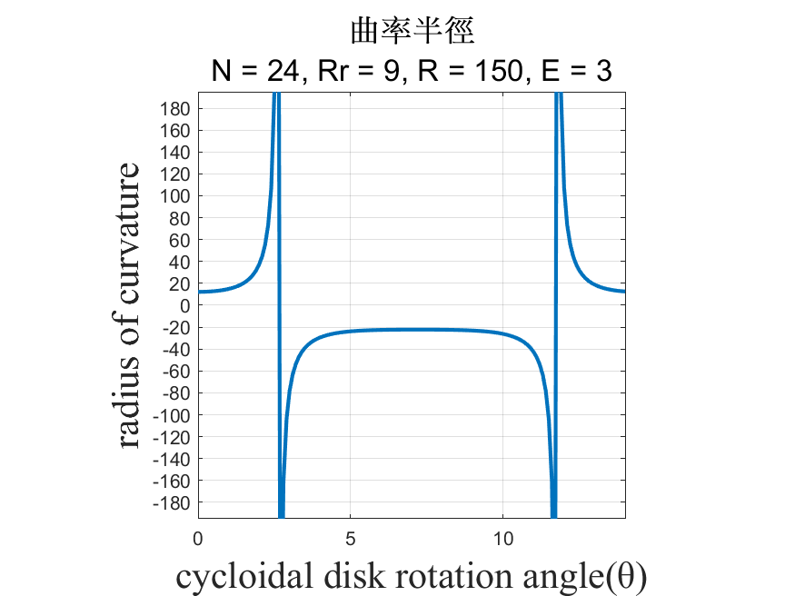
曲率半徑

Slide 15
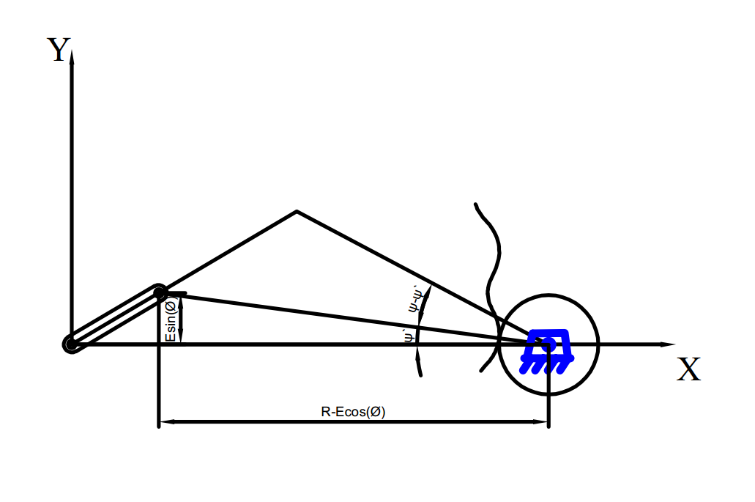

Slide 16
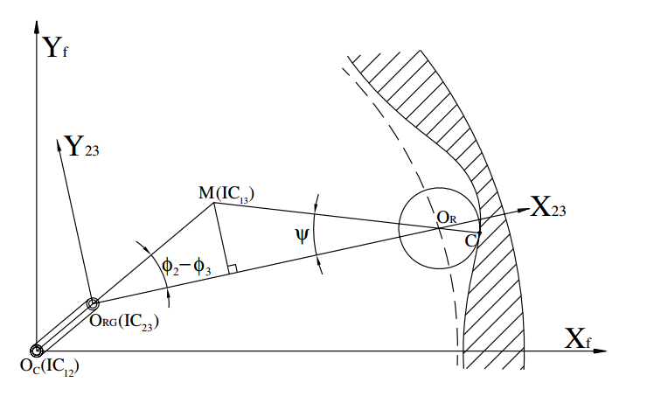

Slide 17
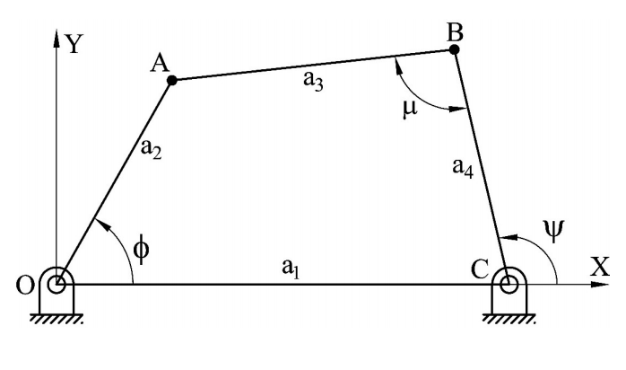
接觸比
A₄ = R_{c} + R_{r}

Slide 18
未來目標

